Slide 1
Python

Slide 2
Features of Python
Interpreted – No need of compiler
Interactive
Object-Oriented
Beginner's Language
Easy-to-learn
Easy-to-read
Easy-to-maintain
A broad standard library support
Portable
Extendable
Databases
GUI Programming
Scalable
Supports functional and structured programming too.
It can be used as a scripting language or can be compiled to byte-code for building large applications.
Supports dynamic type checking.
Supports automatic garbage collection.
Easily integrated with C, C++, COM, ActiveX, CORBA, and Java.

Slide 3
Python History
Developed by Guido van Rossum in the late eighties and early nineties at the National Research Institute for Mathematics and Computer Science in the Netherlands.
Derived from ABC, Modula-3, C, C++, Algol-68, SmallTalk, and Unix shell and other scripting languages.
Copyrighted under the GNU General Public License (GPL).
Python 1.0: released in November 1994.
Python 2.0: released in 2000.
Python 2.7.11 is the latest edition of Python 2.
Python 3.0 was released in 2008.
Python 3.13 is the latest version in April 2024.

Slide 4
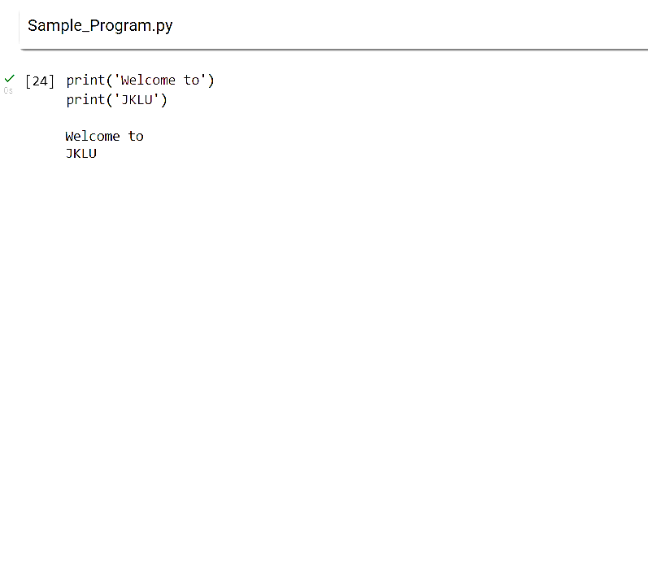
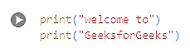
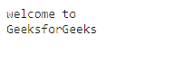
User Program
Filename, preferred extension is py

Slide 5
About various editors of python
Python Terminal
Python IDLE
Jupyter Notebook
Google Colab
Online Judges
VS Code, …

Slide 6
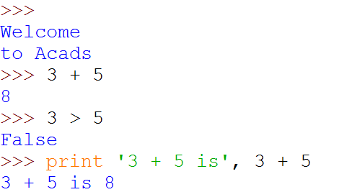
Python Shell is Interactive
IN[1]: print(“Welcome \n to Geeksforgeeks”)
IN[1]:
Python Shell Prompt
Geeksforgeeks
IN[2]:
User Commands
(Statements)
IN[3]:
IN[4]:
(
)
Outputs

Slide 7
Interacting with Python Programs
Python program communicates its results to user using print
Most useful programs require information from users
Name and age for a travel reservation system
Python uses input to read user input as a string (str)

Slide 8
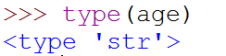
Input
Take as argument a string to print as a prompt
Returns the user typed value as a string
details of how to process user string later
IN[1]:
(
)
IN[2]:
IN[3]:

Slide 9
Elements of Python
A Python program is a sequence of definitions and commands (statements)
Commands manipulate objects
Each object is associated with a Type
Type:
A set of values
A set of operations on these values
Expressions: An operation (combination of objects and operators)

Slide 10
Types in Python
int
Bounded integers, e.g. 732 or -5
float
Real numbers, e.g. 3.14 or 2.0
long (NO LONGER IN PYTHON-3)
Long integers with unlimited precision
str
Strings, e.g. ‘hello’ or ‘C’

Slide 11
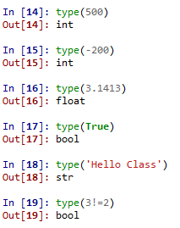
Example of Types

Slide 12
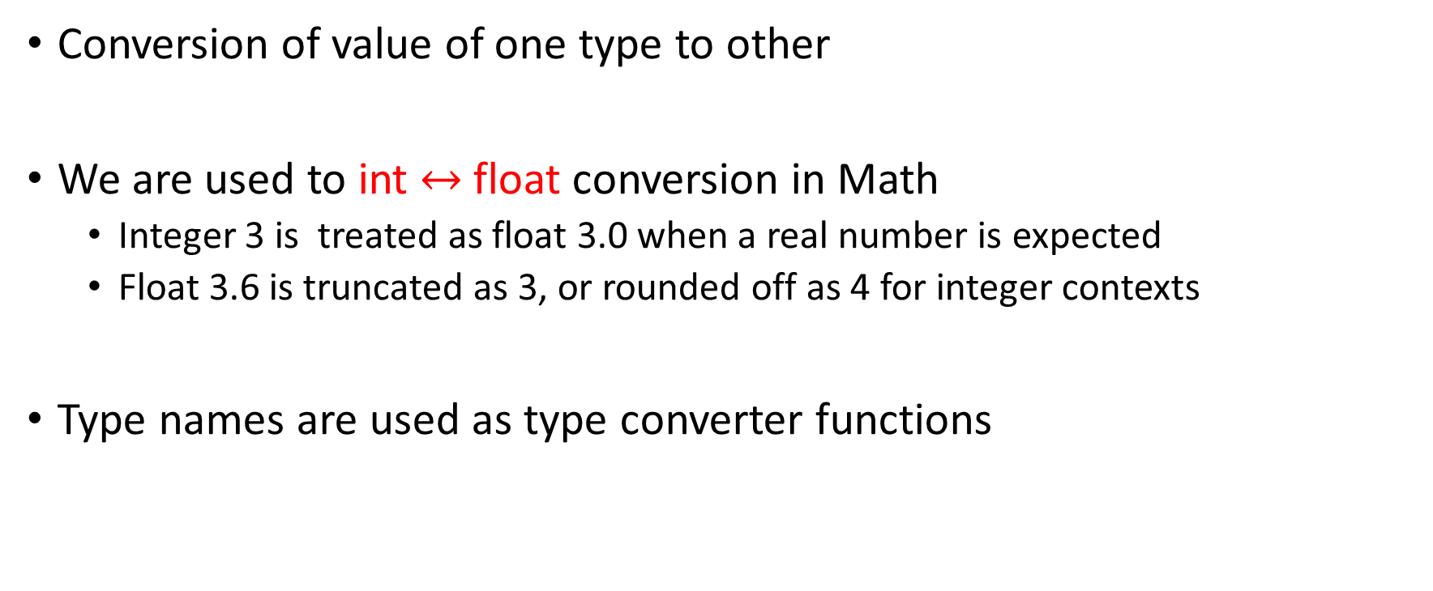
Type Conversion (Type Casting)
Conversion of value of one type to other
We are used to int $↔$float conversion in Math
Integer 3 is treated as float 3.0 when a real number is expected
Float 3.6 is truncated as 3, or rounded off as 4 for integer contexts
Type names are used as type converter functions

Slide 13
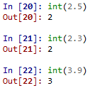
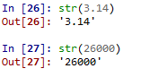
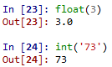
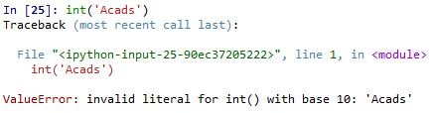
Type Conversion Examples
Note that float to int conversion
is truncation, not rounding off

Slide 14
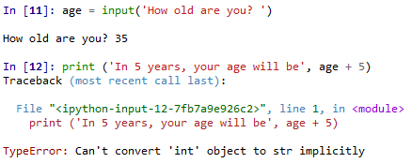
Type Conversion and Input

Slide 15
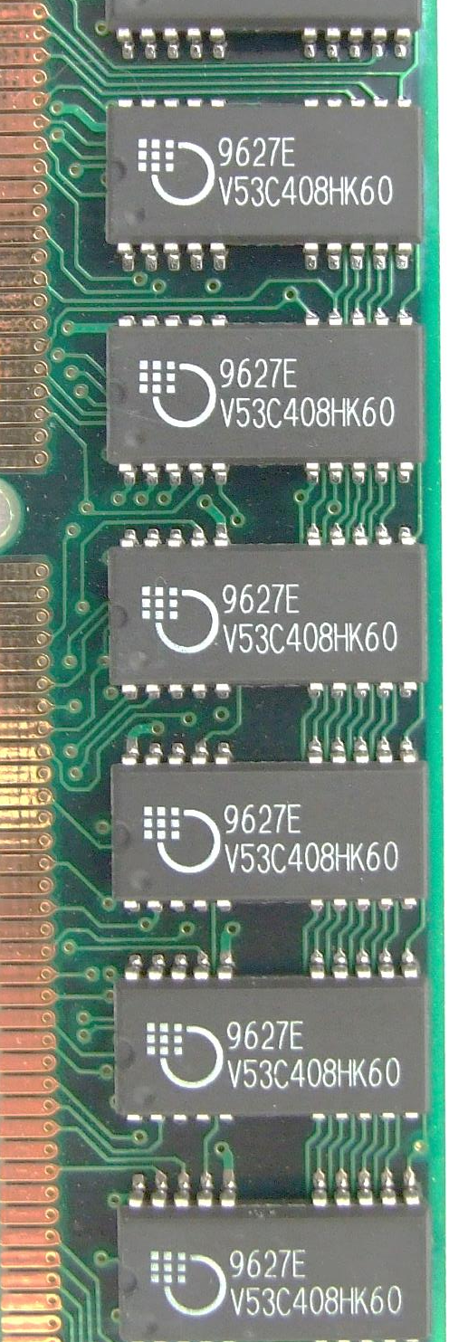
Variables
A name associated with an object
Assignment used for binding
m = 64;
c = ‘Geeks’;
f = 3.1416;
Variables can change their bindings
f = 2.7183;
del(variable,….) removes definition of variables
m
64
Geeks
c
3.1416
f
2.7183

Slide 16
Operators
+ | - | * | // | / | % | **
Arithmetic
Relational
Assignment
Logical
Bitwise
Membership
Identity
== | != | > | < | >= | <=
= | += | -= | *= | //= | /= | %= | **=
and | or | not
& | | | ^ | ~ | >> | <<
in | not in
is | is not

Slide 17
Assignment Statement
A simple assignment statement
Variable = Expression;
Computes the value (object) of the expression on the right-hand side expression (RHS)
Associates the name (variable) on the left-hand side (LHS) with the RHS value
= is known as the assignment operator.

Slide 18
Multiple Assignments
Python allows multiple assignments
x, y = 10, 20
Evaluation of multiple assignment statement:
All the expressions on the RHS of the = are first evaluated before any binding happens.
Values of the expressions are bound to the corresponding variable on the LHS.
x, y = 10, 20
x, y = y+1, x+1
Binds x to 10 and y to 20
x is bound to 21 and y to 11 at the end of the program

Slide 19
Programming using Python
Operators and Expressions

Slide 20
Binary Operations
Op | Meaning | Example | Remarks
+ | Addition | 9+2 is 11
 |  | 9.1+2.0 is 11.1
- | Subtraction | 9-2 is 7
 |  | 9.1-2.0 is 7.1
* | Multiplication | 9*2 is 18
 |  | 9.1*2.0 is 18.2
/ | Division | 9/2 is 4.25 | In Python3
 |  | 9.1/2.0 is 4.55 | Real div.
// | Integer Division | 9//2 is 4
% | Remainder | 9%2 is 1

Slide 21
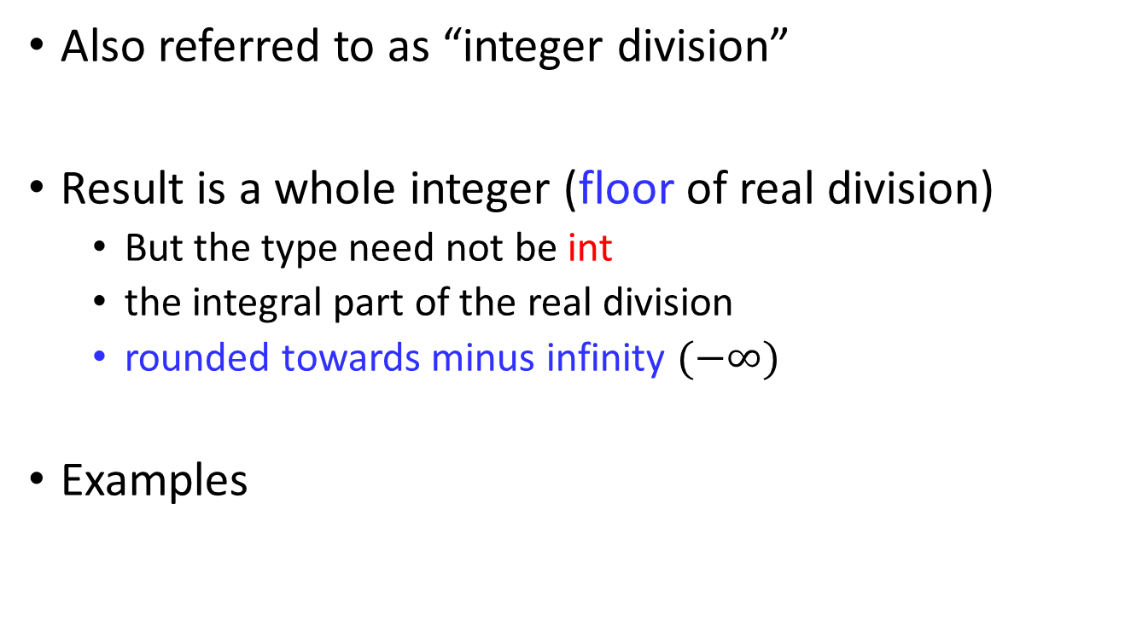
The // operator
Also referred to as “integer division”
Result is a whole integer (floor of real division)
But the type need not be int
the integral part of the real division
rounded towards minus infinity $(−∞)$
Examples
9//4 is 2 | (-1)//2 is -1 | (-1)//(-2) is 0
1//2 is 0 | 1//(-2) is -1 | 9//4.5 is 2.0

Slide 22
The % operator
The remainder operator % (Modulus Division) returns the remainder of the result of dividing its first operand by its second.
9%4 is 1 | (-1)%2 is 1 | (-1)//(-2) is 0
9%4.5 is 0.0 | 1%(-2) is 1 | 1%0.6 is 0.4

Slide 23
Practice Problem…..
WAP
To read four numbers and find the sum of them.
Hint: use input(), and map().
Convert the type of raw input into float type.
Take multiple distinct input from the user and prompt which number is repeated.
Check if a number is even using bitwise operation.
Encrypt and Decrypt a number using symmetric key.
Swapping of two Numbers (Using bitwise and assignment operator)

Slide 24
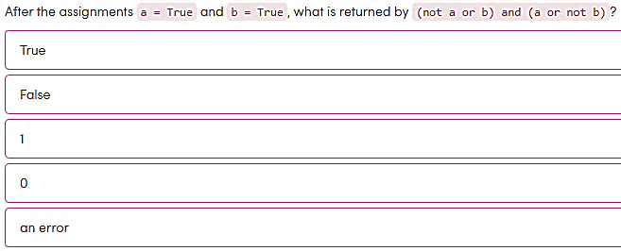
True
False
1
0
Error
Notes:
True

Slide 25
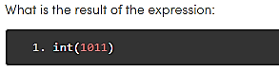
1011
11
13
1101
Notes:
1011

Slide 26
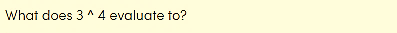
81
12
0.75
7
-7
Notes:
XOR 7

Slide 27
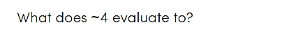
-4
-3
+3
-5
Notes:
-5

Slide 28
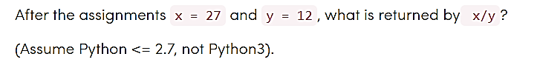
2.25
3
2
3.0
None
It is an integer division in python 2.x

Slide 29
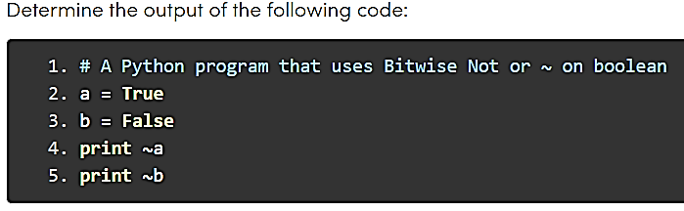
True
False
1
0
True
True
-2
-1
Notes:
C

Slide 30
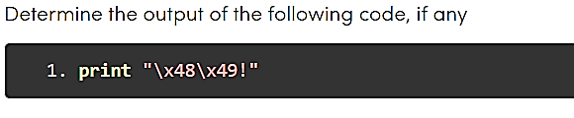
4849!
48 49!
HI!
Syntax Error
Notes:
HI!

Slide 31
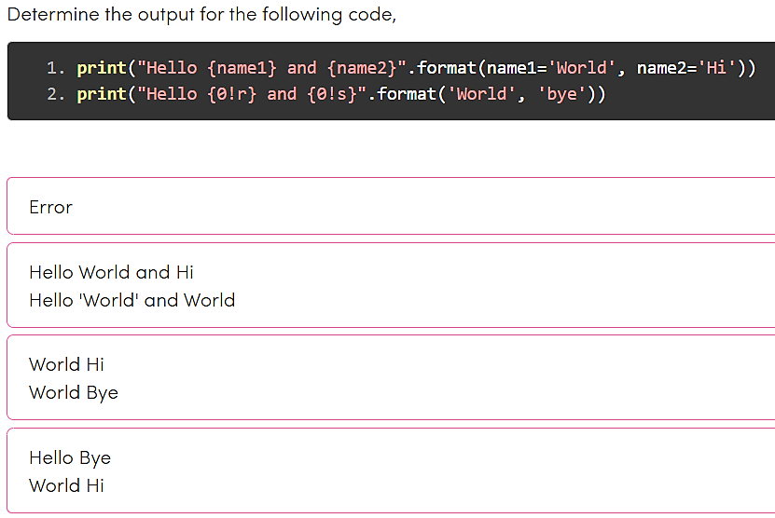
Notes:
B

Slide 32


Conditional Statements
In daily routine
If it is very hot, I will skip exercise.
If there is a quiz tomorrow, I will first study and then sleep. Otherwise, I will sleep now.
If I have to buy coffee, I will go left. Else I will go straight.

Slide 33
if-else statement
Compare two integers and print the min.
if x < y:
print (x)
else:
print (y)
print (‘is the minimum’)
Check if x is less than y.
If so, print x
Otherwise, print y.

Slide 34
Indentation
Indentation is important in Python
grouping of statement (block of statements)
no explicit brackets, e.g. { }, to group statements
x,y = 6,10
if x < y:
print (x)
else:
print (y)
print (‘is the min’)
Run the program
x
y
6
10
Output
skipped
6

Slide 35
if statement (no else!)
General form of the if statement
Execution of if statement
First the expression is evaluated.
If it evaluates to a true value, then S1 is executed and then control moves to the S2.
If expression evaluates to false, then control moves to the S2 directly.
if boolean-expr :
S1
S2
true
false
S1
S2

Slide 36
if-else statement
General form of the if-else statement
Execution of if-else statement
First the expression is evaluated.
If it evaluates to a true value, then S1 is executed and then control moves to S3.
If expression evaluates to false, then S2 is executed and then control moves to S3.
S1/S2 can be blocks of statements!
if boolean-expr :
S1
else:
S2
S3
true
false
S1
S2
S3

Slide 37
Nested if, if-else
if a <= b:
if a <= c:
…
else:
…
else:
if b <= c :
…
else:
if b <= c :
…
else:
if b <= c :
…

Slide 38
Elif
A special kind of nesting is the chain of if-else-if-else-… statements
Can be written elegantly using if-elif-..-else
if cond1:
s1
else:
if cond2:
s2
else:
if cond3:
s3
else:
…
if cond1:
s1
elif cond2:
s2
elif cond3:
s3
elif
…
else
last-block-of-stmt

Slide 39
Summary of if, if-else
if-else, nested if's, elif.
Multiple ways to solve a problem
issues of readability, maintainability, and efficiency

Slide 40
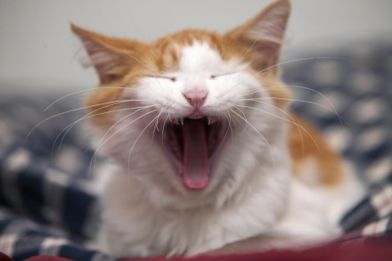
Class Quiz
What is the value of expression:
Run time crash/error
I don’t know / I don’t care
False
True
(5<2) and (3/0 > 1)
(5<2) and (3/1 > 1)
The correct answer is
False
The correct answer is
a

Slide 41
Short-cut Evaluation
Do not evaluate the second operand of binary logical operator if the result can be deduced from the first operand
Also applies to nested logical operators
not( (2>5) and (3/1 < 1) ) or (4/2 < 2)
Evaluates to true
true
false
false
true

Slide 42
3 Factors for Expression Evaluation
Precedence
Applied to two different operators
+ and *, - and *, and and or, …
Associativity
Applied to operators of same type
* and *, + and -, * and /, …
Order
Precedence and associativity identify the operands for each operator
Not which operand is evaluated first
Python evaluates expressions from left to right
While evaluating an assignment, the right-hand side is evaluated before the left-hand side.
Notes:
NOTE: add example to show the effect of order of evaluation

Slide 43
Class Quiz
What is the output of the following program:
y = 1/3
if y != 0.3:
print ('Launch a Missile')
else:
print ("Let's have peace")
Launch a Missile

Slide 44
Caution about Using Floats
Representation of real numbers in a computer can not be exact
Computers have limited memory to store data
Between any two distinct real numbers, there are infinitely many real numbers.
On a typical machine running Python, there are 53 bits of precision available for a Python float

Slide 45
Caution about Using Floats
The value stored internally for the decimal number 0.1 is the binary fraction
Equivalent to decimal value
Approximation is similar to decimal approximation 1/3 = 0.333333333...
No matter how many digits you use, you have an approximation
0.00011001100110011001100110011001100110011001100110011010
0.1000000000000000055511151231257827021181583404541015625

Slide 46
Comparing Floats
Because of the approximations, comparison of floats is not exact.
Solution?
Instead of
x == y
use
abs(x-y) <= epsilon
where epsilon is a suitably chosen small value

Slide 47
Practice Problem…..
WAP
To accept two integers and check whether they are equal or not.
To find the largest of three numbers.
To calculate the root of a Quadratic Equation.
Read a number of 5 digits as 12345 and then find the squared sum of each digit as 1**2+2**2+3**2+4**2+5**2.
Read a number of 5 digits as 12345 and then find the reverse of it as 54321.
A k-digits number is called Armstrong number if it is equal to the sum of kth power of its digits. Eg 153 = 1**3 + 5**3 + 3**3 = 1 + 125 + 27 = 153 and 1634 = 1**4 + 6**4 + 3**4 + 4**4.
Generate all possible Armstrong numbers between 0 to 5000.

Slide 48
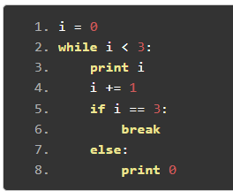
0 0 1 0 2 0
0 0 1 1 2 2
0 1 2
0 0 1 0 2
Notes:
0 0 1 0 2

Slide 49
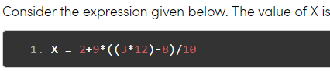
30.0
30.8
28.4
27.2
Notes:
27.2

Slide 50
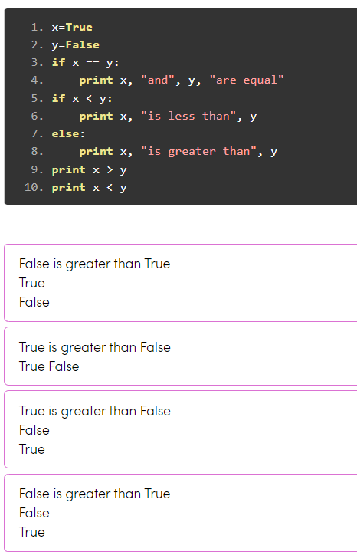
Notes:
Option 2

Slide 51
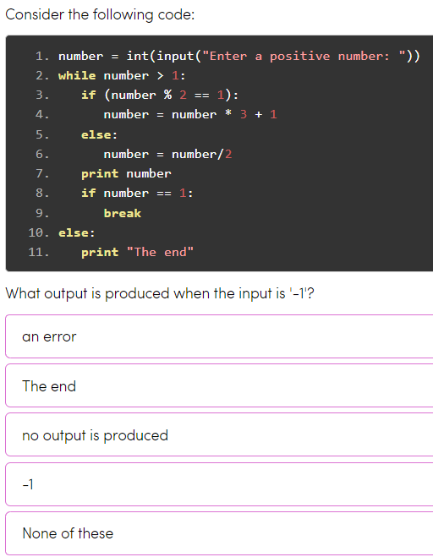
An error
The end
No output is produced
-1
None
Notes:
Option 2

Slide 52
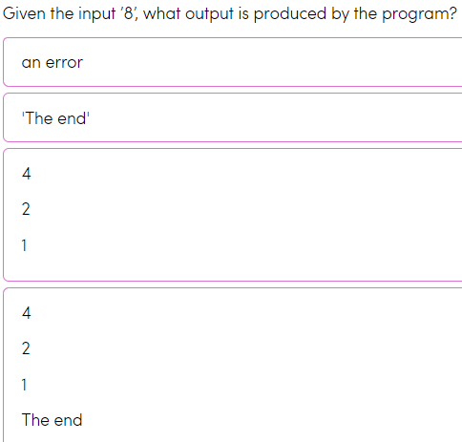

Slide 53
GATE PYQ

Slide 54
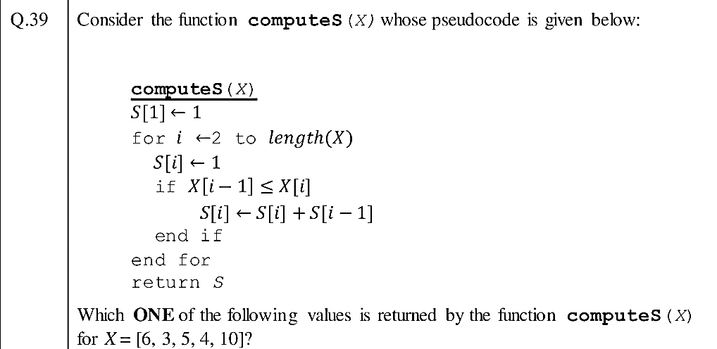
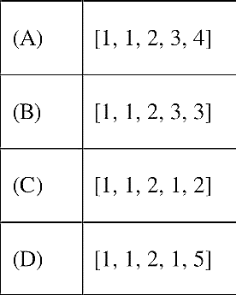
Gate DA -2024

Slide 55
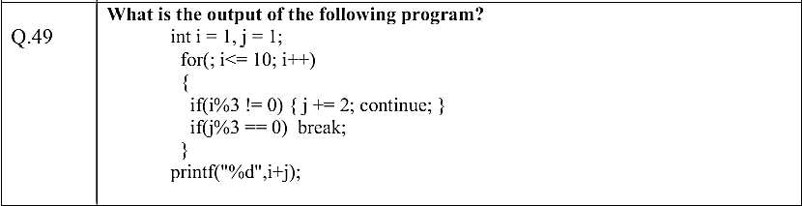
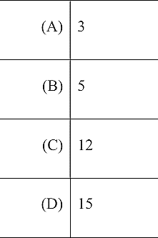
Gate DA –2024
Sample Paper

Slide 56

Any question?

